Slide 1
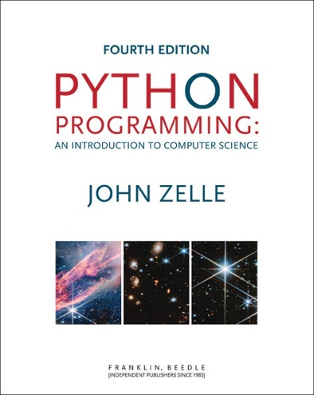
Python Programming: An Introduction to Computer Science
Chapter 6
Decision Structures

Slide 2
Objectives
To understand the simple decision programming pattern and its implementation using a Python if statement.
To understand the two-way decision programming pattern and its implementation using a Python if-else statement.

Slide 3
Objectives
To understand the multi-way decision programming pattern and its implementation using a Python if-elif-else statement.
To understand the idea of exception handling and be able to write simple exception handling code that catches standard Python run-time errors.

Slide 4
Objectives
To understand the concept of Boolean expressions and the bool data type.
To be able to read, write, and implement algorithms that employ decision structures, including those that employ sequences of decisions and nested decision structures.

Slide 5
Simple Decisions
So far, we’ve viewed programs as sequences of instructions that are followed one after the other.
While this is a fundamental programming concept, it is not sufficient in itself to solve every problem. We need to be able to alter the sequential flow of a program to suit a particular situation.

Slide 6
Simple Decisions
Control structures allow us to alter this sequential program flow.
In this chapter, we’ll learn about decision structures, which are statements that allow a program to execute different sequences of instructions for different cases, allowing the program to “choose” an appropriate course of action.

Slide 7
Example: Temperature Warnings
Let’s return to our Celsius to Fahrenheit temperature conversion program from Chapter 2.
# convert.py
# A program to convert Celsius temps to Fahrenheit
# by: Susan Computewell
def main():
celsius = float(input("What is the Celsius temperature? "))
fahrenheit = 9/5 * celsius + 32
print("The temperature is", fahrenheit, "degrees Fahrenheit.")

Slide 8
Example: Temperature Warnings
Let’s say we want to modify the program to print a warning when the weather is extreme.
Any temperature over 90 degrees Fahrenheit and lower than 30 degrees Fahrenheit will cause a hot and cold weather warning, respectively.

Slide 9
Example: Temperature Warnings
Input the temperature in degrees Celsius (call it celsius)
Calculate fahrenheit as 9/5 celsius + 32
Output fahrenheit
If fahrenheit > 90 print a heat warning
If fahrenheit > 30 print a cold warning

Slide 10
Example: Temperature Warnings
This new algorithm has two simple decisions at the end. The indentation indicates that a step should be performed only if the condition listed in the previous line is true.

Slide 11
Example: Temperature Warnings

Slide 12
Example: Temperature Warnings
# convert2.py
# A program to convert Celsius temps to Fahrenheit.
# This version issues heat and cold warnings.
def main():
celsius = float(input("What is the Celsius temperature? "))
fahrenheit = 9 / 5 * celsius + 32
print("The temperature is", fahrenheit, "degrees fahrenheit.")
if fahrenheit > 90:
print("It's really hot out there, be careful!")
if fahrenheit < 30:
print("Brrrrr. Be sure to dress warmly")
main()

Slide 13
Example: Temperature Warnings
The Python if statement is used to implement the decision.
if <condition>: <body>
The body is a sequence of one or more statements indented under the if heading.

Slide 14
Example: Temperature Warnings
The semantics of the if should be clear.
First, the condition in the heading is evaluated.
If the condition is true, the sequence of statements in the body is executed, and then control passes to the next statement in the program.
If the condition is false, the statements in the body are skipped, and control passes to the next statement in the program.

Slide 15
Example: Temperature Warnings

Slide 16
Example: Temperature Warnings
The body of the if either executes or not depending on the condition. In any case, control then passes to the next statement after the if.
This is a one-way or simple decision.

Slide 17
Forming Simple Conditions
What does a condition look like?
At this point, let’s use simple comparisons.
<expr> <relop> <expr>
<relop> is short for relational operator

Slide 18
Forming Simple Conditions
Python | Mathematics | Meaning
< | < | Less than
<= | ≤ | Less than or equal to
== | = | Equal to
>= | ≥ | Greater than or equal to
> | > | Greater than
!= | ≠ | Not equal to

Slide 19
Forming Simple Conditions
Notice the use of == for equality. Since Python uses = to indicate assignment, a different symbol is required for the concept of equality.
A common mistake is using = in conditions!

Slide 20
Forming Simple Conditions
Conditions may compare either numbers or strings.
When comparing strings, the ordering is lexicographic, meaning that the strings are sorted based on the underlying Unicode. Because of this, all upper-case Latin letters come before lower-case letters. (“Bbbb” comes before “aaaa”)

Slide 21
Forming Simple Conditions
Conditions are based on Boolean expressions, named for the English mathematician George Boole.
When a Boolean expression is evaluated, it produces either a value of true (meaning the condition holds), or it produces false (it does not hold).
Some computer languages use 1 and 0 to represent “true” and “false”.

Slide 22
Forming Simple Conditions
Boolean conditions are of type bool and the Boolean values of true and false are represented by the literals True and False.
>>> 3 < 4
True
>>> 3 * 4 < 3 + 4
False
>>> "hello" == "hello"
True
>>> "Hello" < "hello"
True

Slide 23
Example: Conditional Program Execution
There are several ways of running Python programs.
Some modules are designed to be run directly. These are referred to as programs or scripts.
Others are made to be imported and used by other programs. These are referred to as libraries.
Sometimes we want to create a hybrid that can be used both as a stand-alone program and as a library.

Slide 24
Example: Conditional Program Execution
When we want to start a program once it’s loaded, we include the line main() at the bottom of the code.
Since Python evaluates the lines of the program during the import process, our current programs also run when they are imported into an interactive Python session or into another Python program.

Slide 25
Example: Conditional Program Execution
Generally, when we import a module, we don’t want it to execute!
In a program that can be either run stand-alone or loaded as a library, the call to main at the bottom should be made conditional, e.g. if <condition>: main()

Slide 26
Example: Conditional Program Execution
Whenever a module is imported, Python creates a special variable in the module called __name__ to be the name of the imported module.
Example: >>> import math >>> math.__name__ 'math'

Slide 27
Example: Conditional Program Execution
When imported, the __name__ variable inside the math module is assigned the string ‘math’.
When Python code is run directly and not imported, the value of __name__ is ‘__main__’. E.g.: >>> __name__ '__main__'

Slide 28
Example: Conditional Program Execution
To recap: if a module is imported, the code in the module will see a variable called __name__ whose value is the name of the module.
When a file is run directly, the code will see the value ‘__main__’.
We can change the final lines of our programs to: if __name__ == '__main__': main()
Virtually every Python module ends this way!

Slide 29
Two-Way Decisions
Consider the quadratic program as we left it.
# quadratic.py
# A program that computes the real roots of a quadratic equation.
# Note: This program crashes if the equation has no real roots.
import math
def main():
print("This program finds the real solutions to a quadratic\n")
a = float(input("Enter coefficient a: "))
b = float(input("Enter coefficient b: "))
c = float(input("Enter coefficient c: "))
discRoot = math.sqrt(b * b - 4 * a * c)
root1 = (-b + discRoot) / (2 * a)
root2 = (-b - discRoot) / (2 * a)
print("\nThe solutions are:", root1, root2)

Slide 30
Two-Way Decisions
As per the comment, when b²-4ac < 0, the program crashes.
This program finds the real solutions to a quadratic
Please enter the coefficients (a, b, c): 1,1,2
Traceback (most recent call last):
File "C:\Documents and Settings\Terry\My Documents\Teaching\W04\CS 120\Textbook\code\chapter3\quadratic.py", line 21, in -toplevel-
main()
File "C:\Documents and Settings\Terry\My Documents\Teaching\W04\CS 120\Textbook\code\chapter3\quadratic.py", line 14, in main
discRoot = math.sqrt(b * b - 4 * a * c)
ValueError: math domain error

Slide 31
Two-Way Decisions
We can check for this situation. Here’s our first attempt.
# quadratic2.py
# A program that computes the real roots of a quadratic equation.
# Bad version using a simple if to avoid program crash
import math
def main():
print("This program finds the real solutions to a quadratic\n")
a = float(input("Enter coefficient a: "))
b = float(input("Enter coefficient b: "))
c = float(input("Enter coefficient c: "))
discrim = b * b - 4 * a * c
if discrim >= 0:
discRoot = math.sqrt(discrim)
root1 = (-b + discRoot) / (2 * a)
root2 = (-b - discRoot) / (2 * a)
print("\nThe solutions are:", root1, root2)

Slide 32
Two-Way Decisions
We first calculate the discriminant (b²-4ac) and then check to make sure it’s nonnegative. If it is, the program proceeds and we calculate the roots.
Look carefully at the program. What’s wrong with it? Hint: What happens when there are no real roots?

Slide 33
Two-Way Decisions
This program finds the real solutions to a quadratic
Enter coefficient a: 1
Enter coefficient b: 1
Enter coefficient c: 1
>>>
This is almost worse than the version that crashes, because we don’t know what went wrong!

Slide 34
Two-Way Decisions
We could add another if to the end: if discrim < 0: print("The equation has no real roots!" )
This works, but feels wrong. We have two decisions, with mutually exclusive outcomes (if discrim >= 0 then discrim < 0 must be false, and vice versa).

Slide 35
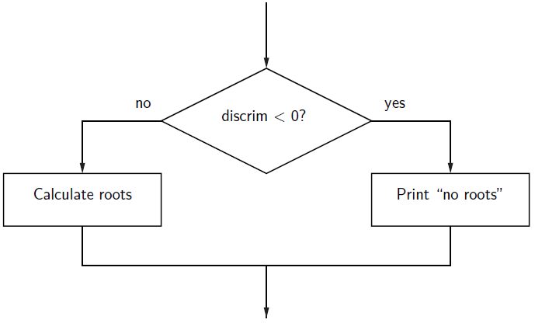
Two-Way Decisions

Slide 36
Two-Way Decisions
In Python, a two-way decision can be implemented by attaching an else clause onto an if clause.
This is called an if-else statement: if <condition>: <statements> else: <statements>

Slide 37
Two-Way Decisions
When Python encounters this structure, it first evaluates the condition. If the condition is true, the statements under the if are executed.
If the condition is false, the statements under the else are executed.
In either case, the statements following the if-else are executed after either set of statements are executed.

Slide 38
Two-Way Decisions
# quadratic3.py
# A program that computes the real roots of a quadratic equation.
# Illustrates use of a two-way decision
import math
def main():
print "This program finds the real solutions to a quadratic\n"
a = float(input("Enter coefficient a: "))
b = float(input("Enter coefficient b: "))
c = float(input("Enter coefficient c: "))
discrim = b * b - 4 * a * c
if discrim < 0:
print("\nThe equation has no real roots!")
else:
discRoot = math.sqrt(b * b - 4 * a * c)
root1 = (-b + discRoot) / (2 * a)
root2 = (-b - discRoot) / (2 * a)
print ("\nThe solutions are:", root1, root2 )

Slide 39
Two-Way Decisions
This program finds the real solutions to a quadratic
Enter coefficient a: 1
Enter coefficient b: 1
Enter coefficient c: 2
The equation has no real roots!
>>>
This program finds the real solutions to a quadratic
Enter coefficient a: 2
Enter coefficient b: 5
Enter coefficient c: 2
The solutions are: -0.5 -2.0

Slide 40
Multi-Way Decisions
The newest program is great, but it still has some quirks! This program finds the real solutions to a quadratic
Enter coefficient a: 1
Enter coefficient b: 2
Enter coefficient c: 1
The solutions are: -1.0 -1.0

Slide 41
Multi-Way Decisions
While correct, this method might be confusing for some people. It looks like it has mistakenly printed the same number twice!
Double roots occur when the discriminant is exactly 0, and then the roots are –b/2a.
It looks like we need a three-way decision!

Slide 42
Multi-Way Decisions
Check the value of discrim when < 0: handle the case of no roots when = 0: handle the case of a double root when > 0: handle the case of two distinct roots
We can do this with two if-else statements, one inside the other.
Putting one compound statement inside of another is called nesting.

Slide 43
Multi-Way Decisions
if discrim < 0:
print("Equation has no real roots")
else:
if discrim == 0:
root = -b / (2 * a)
print("There is a double root at", root)
else:
# Do stuff for two roots

Slide 44
Multi-Way Decisions

Slide 45
Multi-Way Decisions
Imagine if we needed to make a five-way decision using nesting. The if-else statements would be nested four levels deep!
There is a construct in Python that achieves this, combining an else followed immediately by an if into a single elif.

Slide 46
Multi-Way Decisions
if <condition1>: <case1 statements> elif <condition2>: <case2 statements> elif <condition3>: <case3 statements> … else: <default statements>

Slide 47
Multi-Way Decisions
This form sets off any number of mutually exclusive code blocks.
Python evaluates each condition in turn looking for the first one that is true. If a true condition is found, the statements indented under that condition are executed, and control passes to the next statement after the entire if-elif-else.
If none are true, the statements under else are performed.
The else is optional. If there is no else, it’s possible no indented block would be executed.

Slide 48
Multi-Way Decisions
# quadratic4.py
import math
def main():
print("This program finds the real solutions to a quadratic\n")
a = float(input("Enter coefficient a: "))
b = float(input("Enter coefficient b: "))
c = float(input("Enter coefficient c: "))
discrim = b * b - 4 * a * c
if discrim < 0:
print("\nThe equation has no real roots!")
elif discrim == 0:
root = -b / (2 * a)
print("\nThere is a double root at", root)
else:
discRoot = math.sqrt(b * b - 4 * a * c)
root1 = (-b + discRoot) / (2 * a)
root2 = (-b - discRoot) / (2 * a)
print("\nThe solutions are:", root1, root2 )

Slide 49
Exception Handling
In the quadratic program we used decision structures to avoid taking the square root of a negative number, thus avoiding a run-time error.
This is true for many programs: decision structures are used to protect against rare but possible errors.

Slide 50
Exception Handling
In the quadratic example, we checked the data before calling sqrt. Sometimes functions will check for errors and return a special value to indicate the operation was unsuccessful.
E.g., a different square root operation might return a –1 to indicate an error (since square roots are never negative, we know this value will be unique).

Slide 51
Exception Handling
discRt = otherSqrt(b*b - 4*a*c) if discRt < 0: print("No real roots.") else: ...
Sometimes programs get so many checks for special cases that the algorithm becomes hard to follow.
Programming language designers have come up with a mechanism to handle exception handling to solve this design problem.

Slide 52
Exception Handling
The programmer can write code that catches and deals with errors that arise while the program is running, i.e., “Do these steps, and if any problem crops up, handle it this way.”
This approach obviates the need to do explicit checking at each step in the algorithm.

Slide 53
Exception Handling
# quadratic5.py
import math
def main():
print ("This program finds the real solutions to a quadratic\n")
try:
a = float(input("Enter coefficient a: "))
b = float(input("Enter coefficient b: "))
c = float(input("Enter coefficient c: "))
discRoot = math.sqrt(b * b - 4 * a * c)
root1 = (-b + discRoot) / (2 * a)
root2 = (-b - discRoot) / (2 * a)
print("\nThe solutions are:", root1, root2)
except ValueError:
print("\nNo real roots")

Slide 54
Exception Handling
The try statement has the following form: try: <body> except <ErrorType>: <handler>
When Python encounters a try statement, it attempts to execute the statements inside the body.
If there is no error, control passes to the next statement after the try…except.

Slide 55
Exception Handling
If an error occurs while executing the body, Python looks for an except clause with a matching error type. If one is found, the handler code is executed.
The original program generated this error with a negative discriminant: Traceback (most recent call last): File "C:\Documents and Settings\Terry\My Documents\Teaching\W04\CS120\Textbook\code\chapter3\quadratic.py", line 21, in -toplevel- main() File "C:\Documents and Settings\Terry\My Documents\Teaching\W04\CS 120\Textbook\code\chapter3\quadratic.py", line 14, in main discRoot = math.sqrt(b * b - 4 * a * c) ValueError: math domain error

Slide 56
Exception Handling
The last line, "ValueError: math domain error", indicates the specific type of error.
Here’s the new code in action:
This program finds the real solutions to a quadratic
Enter coefficient a: 1
Enter coefficient b: 1
Enter coefficient c: 1
No real roots

Slide 57
Exception Handling
Instead of crashing, the exception handler prints a message indicating that there are no real roots.
The try…except can be used to catch any kind of error and provide for a graceful exit.
A single try statement can have multiple except clauses.

Slide 58
Exception Handling
# quadratic6.py
import math
def main():
print("This program finds the real solutions to a quadratic\n")
try:
a = float(input("Enter coefficient a: "))
b = float(input("Enter coefficient b: "))
c = float(input("Enter coefficient c: "))
discRoot = math.sqrt(b * b - 4 * a * c)
root1 = (-b + discRoot) / (2 * a)
root2 = (-b - discRoot) / (2 * a)
print("\nThe solutions are:", root1, root2 )
except ValueError as excObj:
if str(excObj) == "math domain error":
print("No Real Roots")
else:
print("Invalid coefficient given.")
except:
print("\nSomething went wrong, sorry!")

Slide 59
Exception Handling
The multiple excepts act like elifs. If an error occurs, Python will try each except looking for one that matches the type of error.
The bare except at the bottom acts like an else and catches any errors without a specific match.
If there was no bare except at the end and none of the except clauses match, the program would still crash and report an error.

Slide 60
Exception Handling
Exceptions themselves are a type of object.
If you follow the error type with an identifier in an except clause, Python will assign to that identifier the actual exception object.

Slide 61
Study in Design: Max of Three
Now that we have decision structures, we can solve more complicated programming problems. The negative is that writing these programs becomes harder!
Suppose we need an algorithm to find the largest of three numbers.

Slide 62
Study in Design: Max of Three
def main():
x1 = float(input("Please enter three values: "))
x2 = float(input("Please enter three values: "))
x3 = float(input("Please enter three values: "))
# missing code sets max to the value of the largest
print("The largest value is", maxval)

Slide 63
Strategy 1: Compare Each to All
This looks like a three-way decision, where we need to execute one of the following: maxval = x1 maxval = x2 maxval = x3
All we need to do now is preface each one of these with the right condition!

Slide 64
Strategy 1: Compare Each to All
Let’s look at the case where x1 is the largest.
if x1 >= x2 >= x3: maxval = x1
Is this syntactically correct?
Many languages would not allow this compound condition
Python does allow it, though. It’s equivalent to x1 ≥ x2 ≥ x3.

Slide 65
Strategy 1: Compare Each to All
Whenever you write a decision, there are two crucial questions:
When the condition is true, is executing the body of the decision the right action to take?
x1 is at least as large as x2 and x3, so assigning maxval to x1 is OK.
Always pay attention to borderline values!!

Slide 66
Strategy 1: Compare Each to All
Secondly, ask the converse of the first question, namely, are we certain that this condition is true in all cases where x1 is the max?
Suppose the values are 5, 2, and 4.
Clearly, x1 is the largest, but does x1 ≥ x2 ≥ x3 hold?
We don’t really care about the relative ordering of x2 and x3, so we can make two separate tests: x1 >= x2 and x1 >= x3.

Slide 67
Strategy 1: Compare Each to All
We can separate these conditions with and!
if x1 >= x2 and x1 >= x3:
maxval = x1
elif x2 >= x1 and x2 >= x3:
maxval = x2
else:
maxval = x3
We’re comparing each possible value against all the others to determine which one is largest.

Slide 68
Strategy 1: Compare Each to All
What would happen if we were trying to find the max of five values?
We would need four Boolean expressions, each consisting of four conditions anded together.
Yuck!

Slide 69
Strategy 2: Decision Tree
We can avoid the redundant tests of the previous algorithm using a decision tree approach.
Suppose we start with x1 >= x2. This knocks either x1 or x2 out of contention to be the max.
If the conidition is true, we need to see which is larger, x1 or x3.

Slide 70
Strategy 2: Decision Tree
if x1 >= x2: if x1 >= x3: maxval = x1 else: maxval = x3 else: if x2 >= x3: maxval = x2 else maxval = x3

Slide 71
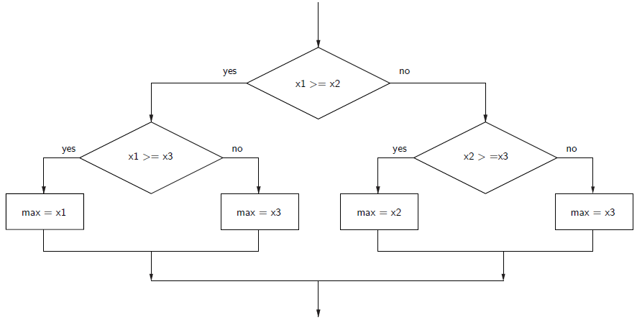
Strategy 2: Decision Tree

Slide 72
Strategy 2: Decision Tree
This approach makes exactly two comparisons, regardless of the ordering of the original three variables.
However, this approach is more complicated than the first. To find the max of four values you’d need if-elses nested three levels deep with eight assignment statements!

Slide 73
Strategy 3: Sequential Processing
How would you solve the problem?
You could probably look at three numbers and just know which is the largest. But what if you were given a list of a hundred numbers?
One strategy is to scan through the list looking for a big number. When one is found, mark it, and continue looking. If you find a larger value, mark it, erase the previous mark, and continue looking.

Slide 74
Strategy 3: Sequential Processing

Slide 75
Strategy 3: Sequential Processing
This idea can easily be translated into Python.
maxval = x1
if x2 > maxval:
maxval = x2
if x3 > maxval:
maxval = x3

Slide 76
Strategy 3: Sequential Programming
This process is repetitive and lends itself to using a loop.
We prompt the user for a number, we compare it to our current max, if it is larger, we update the max value, repeat.

Slide 77
Strategy 3: Sequential Programming
# program: maxn.py
# Finds the maximum of a series of numbers
def main():
n = int(input("How many numbers are there? "))
# Set max to be the first value
max = float(input("Enter a number >> "))
# Now compare the n-1 successive values
for i in range(n-1):
x = float(input("Enter a number >> "))
if x > max:
max = x
print("The largest value is", max)

Slide 78
Strategy 4: Use Python
Python has a built-in function called max that returns the largest of its parameters.
def main(): x1, x2, x3 = eval(input("Please enter three values: ")) print("The largest value is", max(x1, x2, x3))

Slide 79
Some Lessons
There’s usually more than one way to solve a problem.
Don’t rush to code the first idea that pops out of your head. Think about the design and ask if there’s a better way to approach the problem.
Your first task is to find a correct algorithm. After that, strive for clarity, simplicity, efficiency, scalability, and elegance.

Slide 80
Some Lessons
Be the computer.
One of the best ways to formulate an algorithm is to ask yourself how you would solve the problem.
This straightforward approach is often simple, clear, and efficient enough.

Slide 81
Some Lessons
Generality is good.
Consideration of a more general problem can lead to a better solution for some special case.
If the max of n program is just as easy to write as the max of three, write the more general program because it’s more likely to be useful in other situations.

Slide 82
Some Lessons
Don’t reinvent the wheel.
If the problem you’re trying to solve is one that lots of other people have encountered, find out if there’s already a solution for it!
As you learn to program, designing programs from scratch is a great experience!
Truly expert programmers know when to borrow.

